Slide 1
Consumers

Slide 2
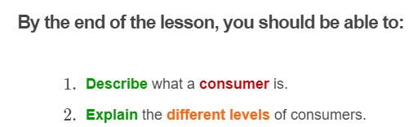
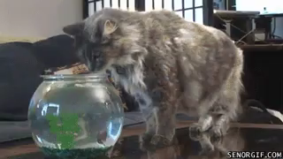

Slide 3
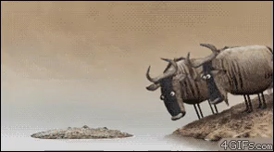
Consumers gain nutrition by eating other organisms.
Consumers need to eat other organisms to survive.

Slide 4
Not all consumers eat the same types of food. Some consumers prefer meat, others prefer plants, and some like a mixture of the two!

Slide 5


Slide 6
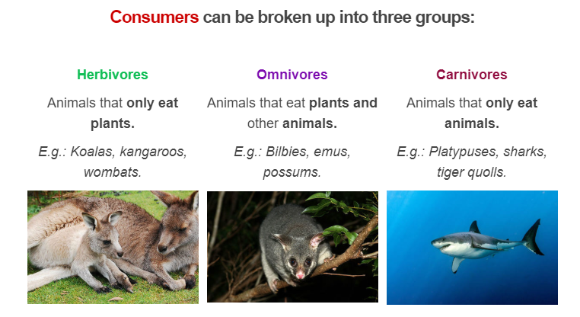

Slide 7
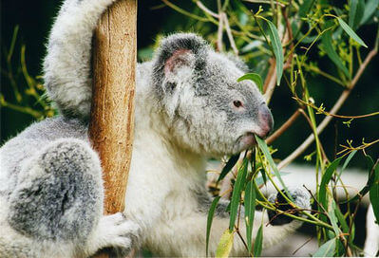
Consumers can be broken down to different levels.
Herbivores, animals that feed directly on producers, are called first order consumers.
A koala is an example of a first order consumer, since it mainly eats eucalyptus leaves.

Slide 8
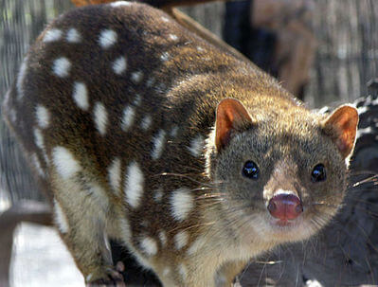
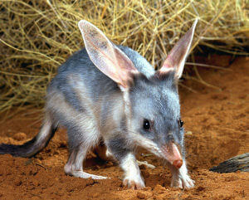
Animals that consume herbivores are second order consumers.
Second order consumers can be either carnivores, because they just eat first order consumers, or omnivores, because they eat first order consumers and plants.
For example, tiger quolls are carnivorous second order consumers because they only eat other animals. Bilbies are omnivorous second order consumers, because they eat insects and plants.

Slide 9

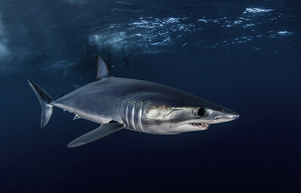
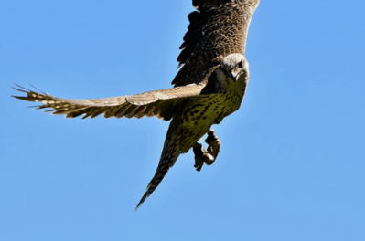
Third order consumers eat lower order consumers and are sometimes called final consumers.
Examples of third order consumers include humans, sharks and raptors.

